Slide 1
World Cup Final Analysis 2023
Prepared by: Digma Patel

Slide 2
Index
Overview
Problem statement
Data set
Team performance analysis
Player performance analysis
Opposition and ground analysis
Temporal analysis

Slide 3
Overview
The World Cup 2023 Data Analysis project aims to delve into the cricketing world, specifically focusing on the performance of teams and players during the prestigious tournament. The dataset provided encapsulates a comprehensive array of features, offering an opportunity for you to conduct a thorough exploratory data analysis (EDA) and extract valuable insights.

Slide 4
Problem Statement
As part of the assigned task, I will conduct a comprehensive exploratory data analysis on the World Cup 2023 dataset. The objective is to reveal patterns, trends, and significant statistics that contribute to a nuanced comprehension of both team and player performance. This analysis will encompass various facets of batting and bowling, focusing on essential metrics such as runs, wickets, strike rate, economy rate, and other pertinent factors.

Slide 5
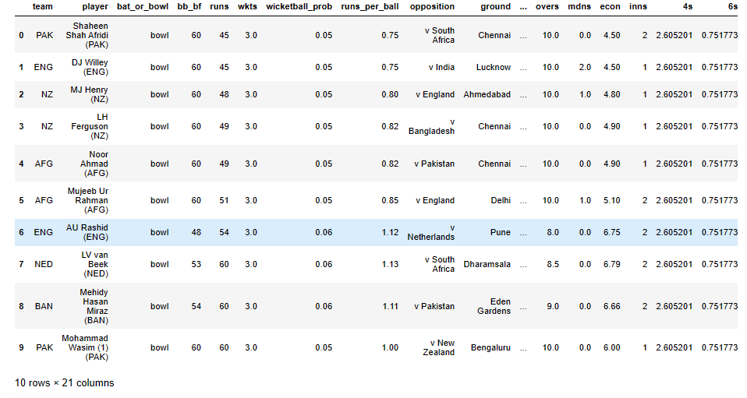
Data Set

Slide 6
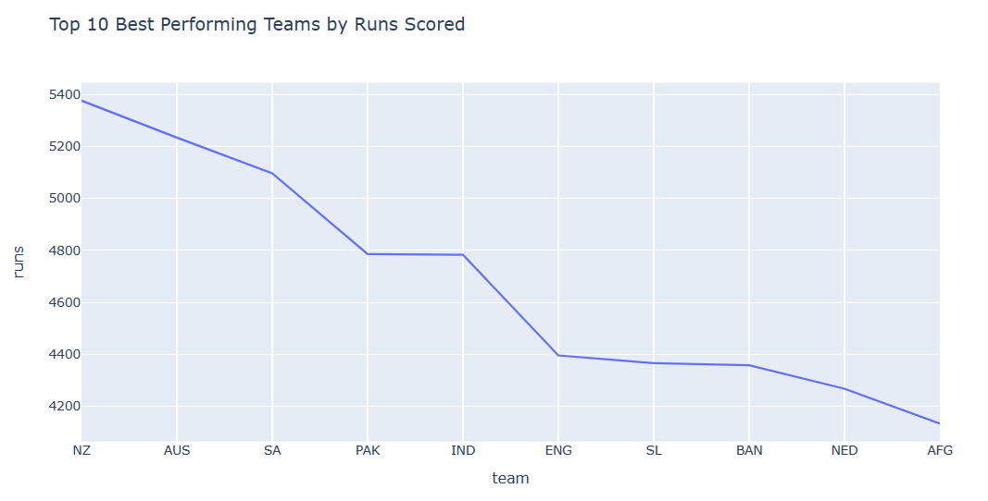
Team Performance Analysis: Team vs Total runs scored
New zealand tops amongs highest run scorer where as Afghanistan being at the bottom.

Slide 7
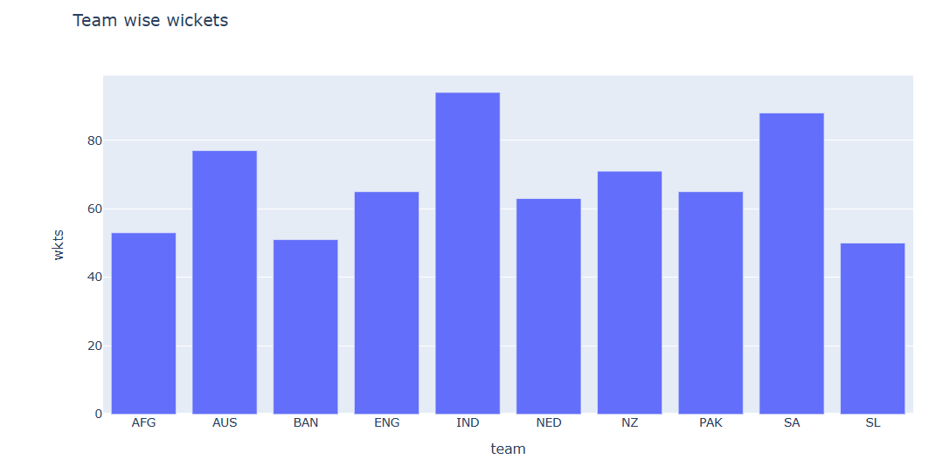
Team performance Analysis: Team vs Wickets taken
Team India beats first position with highest wicket taken throughout the match where as South Africa and Australia marks second and third position respectively.
Moreover, Afghanistan , Bangladesh , Srilanka bags same position

Slide 8
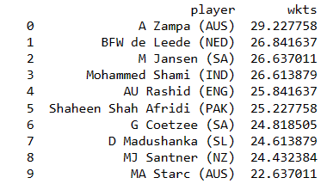
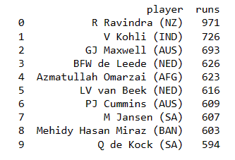
Player Performance Analysis
Top 10 player earning highest wicket
Top 10 player earning highest runs in match

Slide 9
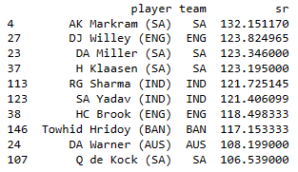
Player performance
Strike rate for AK Markam (SA) and DJ Willey(ENG) are highesh , making contribution to their team for better performance

Slide 10
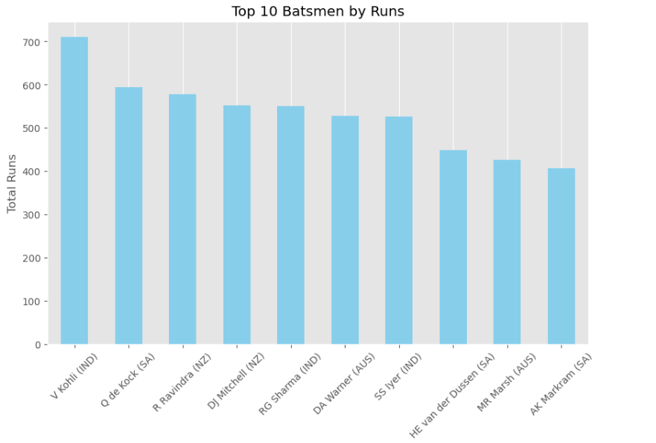
Player performance

Slide 11
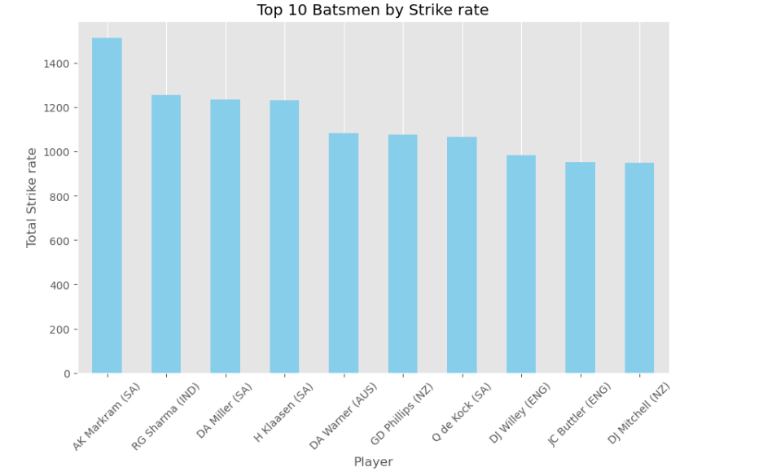
Player performance

Slide 12
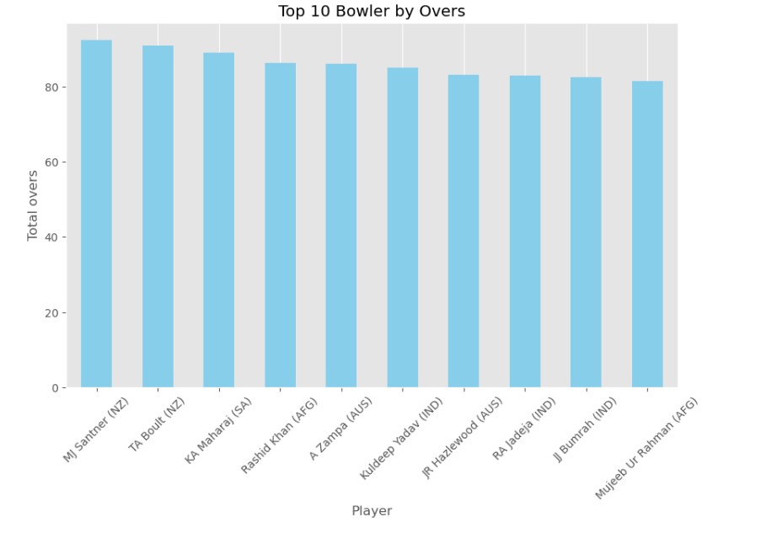
Player performance

Slide 13
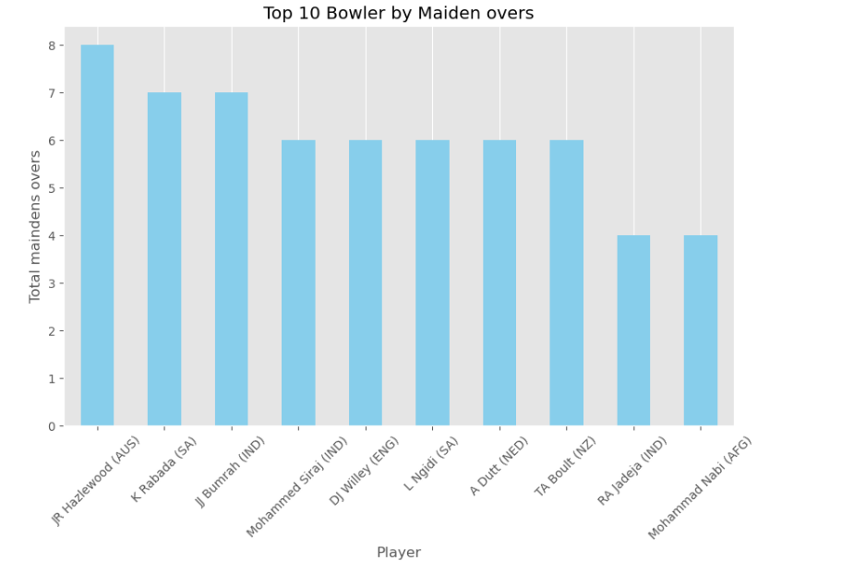
Player performance

Slide 14
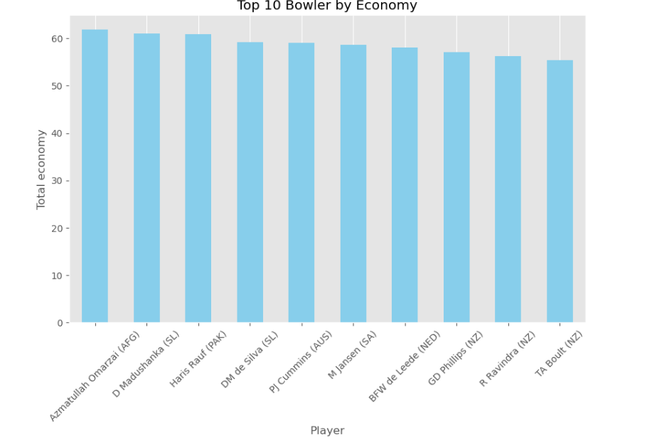
Player Performance

Slide 15
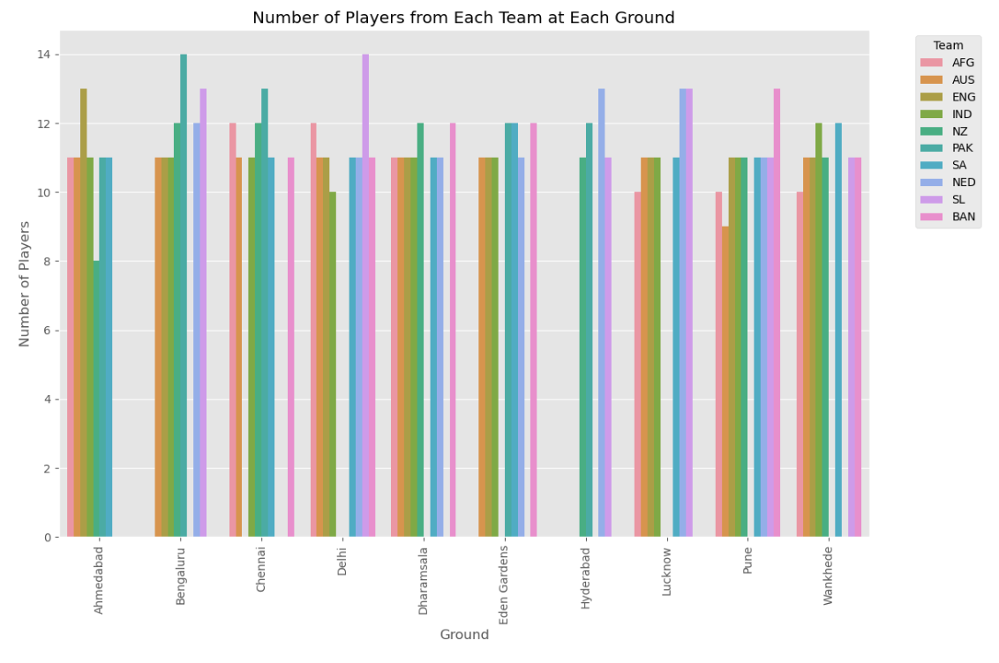
Ground Analysis
On ground of Delhi , Srilankan player have played in higher number then rest teams.

Slide 16
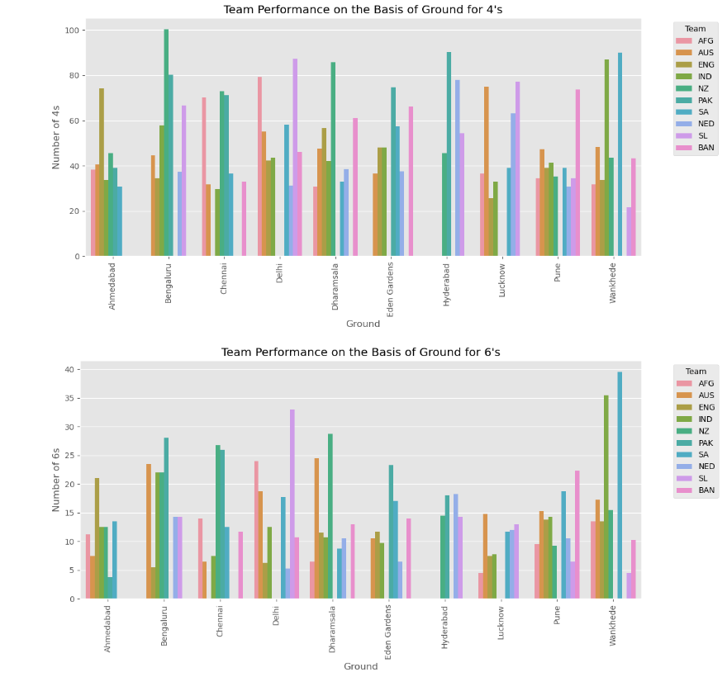
Ground analysis
For a player to hit 4’s Bengaluru ground hits tope where as for hitting 6’s Wankhede ground tops.

Slide 17
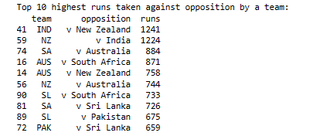
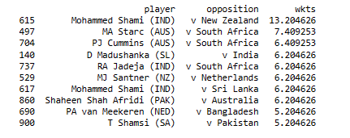
Opposition Analysis
Highest wickets taken
Highest runs made by team

Slide 18
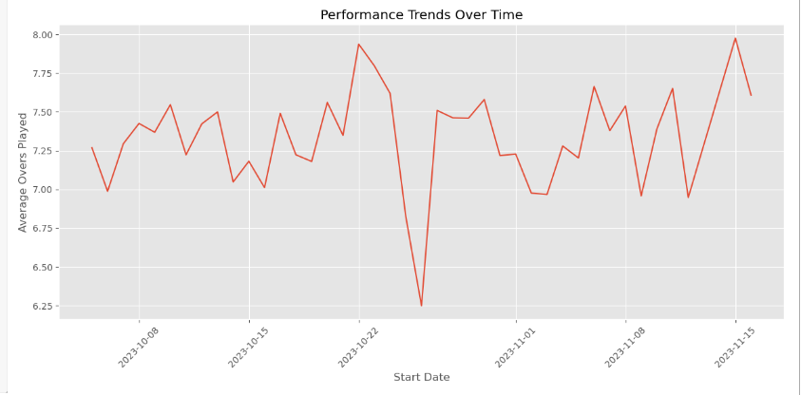
Temporal Analysis
The average over being toped highest in on 15/12/2023 where as at a lowest between 21/10/2023 to 01/12/2023.

Slide 19
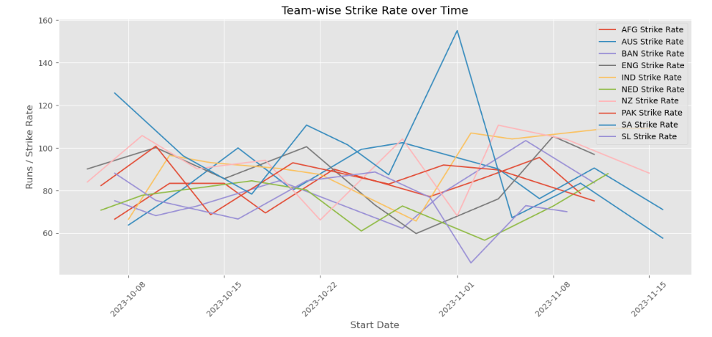
Temporal analysis

Slide 20
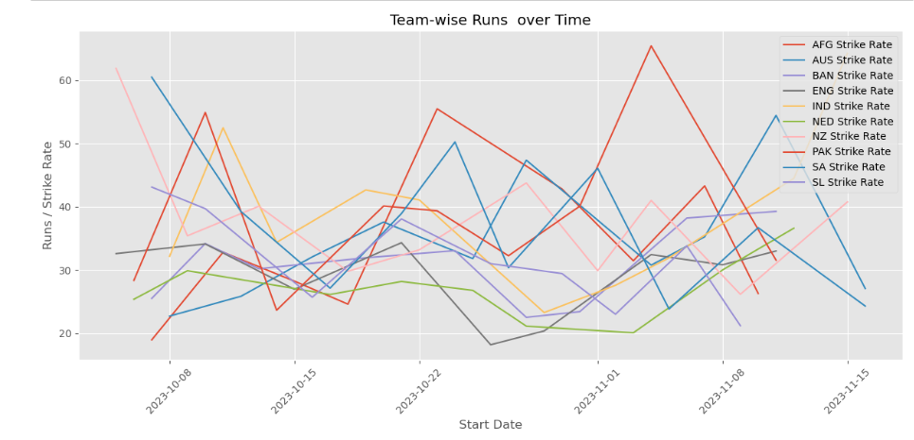
Temporal analysis

Slide 21
Thank you !!

